Slide 1

Department of Computer Science and Engineering
Mini Project
Review 0
Project Synopsis Presentation
IMAGE BASED AUTHENTICATION
Under the Supervision
Dr./Prof. Mamatha Reddy,
Assistant professor (M.tech)
<number>
Presented By:
HARI CHANDAN (22N81A05B9)
TIRUPATHI (22N81A05C4)
MADHUSUDHAN (22N81A05B7)
DESH KUMAR(23N81A0516)
RAGHAVENDRA(22N81A05E8)
Notes:
Title of the project
CSE Dept., SET-Jain University
<number>

Slide 2

Overview
Abstract
Existing system
Problem Statement
Introduction
Social/Environmental Impact
State of the Art work
Methodology
References
*
<number> of 12

Slide 3
Abstract
Image based authentication is a type of authentication method that uses images to verify a user's identity. Instead of entering a password or Pin users select for recognize specific images to gain access to a to a a system, application or device.
leverages human visual recognition, which is strong at identifying familiar images and offers a different authentication method compared to traditional text passwords. This system that relies less on memorizing complex text passwords.
we are using the well known frontend technologies like JAVASCRIPT more visually engaging and potentially more secure authentication method.
*
<number> of 12

Slide 4
EXISTING SYSTEM
Before the rise of sophisticated image-based authentication systems, authentication primarily relied on a few key methods, each with its own set of strengths and weaknesses. Here's a breakdown:
1.PINs (Personal Identification Numbers):Short numerical codes used for authentication, often in banking and ATM transactions.And also susceptible to Shoulder surfing, Brute-force attacks.
2. Ownership-Based Authentication:Physical devices that store authentication credentials.
Examples include Security tokens, Smart cards.
Vulnerabilities include: Loss or theft of the device.
3. Biometric Authentication:
-> Fingerprint Scanning:
Early forms of biometric authentication involved capturing and analyzing fingerprint patterns.
While offering increased security, early systems were: Expensive, Prone to errors, and Raised privacy concerns.

Slide 5
Problem Statement
An alphanumeric password is an old traditional common authentication method. Practically this traditional method is a too insecure system. For example, an attacker may choose an easily guessed user's password, if a user is not using a strong password.
Users may use the same password for multiple devices or sites. These are all insecure characteristics for normal users.
And authentication is one of the important security points where the user has active responsibility for their personal information security. If we use the old traditional password system then there may have the possibility of to dictionary attack, Brute Force Attack.
*
<number> of 12

Slide 6
Introduction
Current status:Currently we are working on the UI (frontend) part of our image based authentication
What you plan to do: Present images in a clear and intuitive manner
→ To allow for feature extraction, and more robust image comparison.
Scope of the project: The scope of the "Image-Based Authentication" project includes the development of a secure and efficient authentication system for user login. The system incorporates with user sign-up process, login process, security question recovery and compatibility
Assumptions: Users possess a strong ability to recognize and recall visual patterns and images
→ Images contain sufficient unique features that are difficult to replicate or guess.
*
<number> of 12

Slide 7
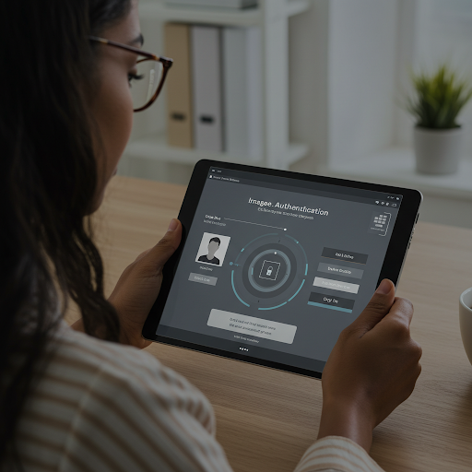
Environmental Impact
Energy Efficiency: The lightweight nature of the system minimizes computational demands, reducing energy consumption for servers and user devices.
Scalability: The architecture supports scaling to accommodate more users with minimal environmental impact, especially when hosted on cloud platforms optimized for energy-efficient operations.
*
<number> of 12

Slide 8
State of the Art-work
Literature survey:
→ "A Comparative Analysis of Graphical and Text-Based Passwords" by R. A. G. A. I. Alnuem, K. T. K. Gopalan, and A. M. A. Baig. This paper presents a comparative analysis of graphical and text-based passwords, discussing the advantages and challenges of using images for authentication. The research focuses on the memorability of graphical passwords, considering how well users can recall image-based sequences compared to text passwords. The study also evaluates security concerns, such as susceptibility to brute-force attacks and usability issues in real world scenarios.
→"The Effectiveness of Image-Based Authentication Systems: Usability and Security" by J. M. N. Tan, A. A. T. Lee, and S. M. N. Tan. This study investigates the effectiveness of image-based authentication systems, focusing on their usability and security. The paper provides a detailed review of various image authentication techniques, such as cognitive authentication systems and graphical password schemes, highlighting the trade-off between security and user experience. The research also addresses user preference and performance in randomized image selection systems.
*
<number> of 12

Slide 9
Methodology
Describe your methods of data collection:The methodology of the image-based authentication system from the provided paragraph, broken down into concise points:
User Sign-up: Users are presented with a grid of images (e.g., 3x3 or 4x4).
Users select a unique sequence of positions on the grid as their authentication pattern.
User Login: The same image grid is displayed, but with randomized image positions.
Users select their pre-defined pattern.
Security Enhancements:
Security question reset: Users can reset patterns via pre-defined security questions.
Usability:
Randomized image grid for each session, enhancing security and leveraging visual memory.
*
<number> of 12

Slide 10
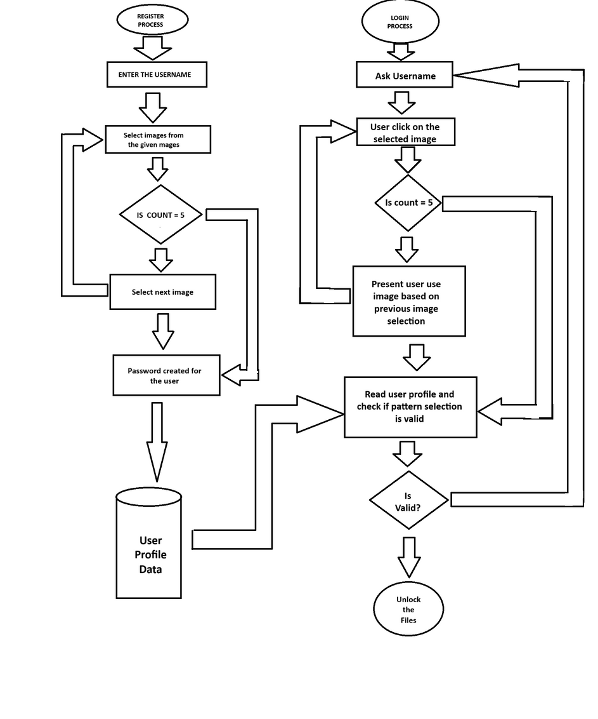
Flow chart

Slide 11
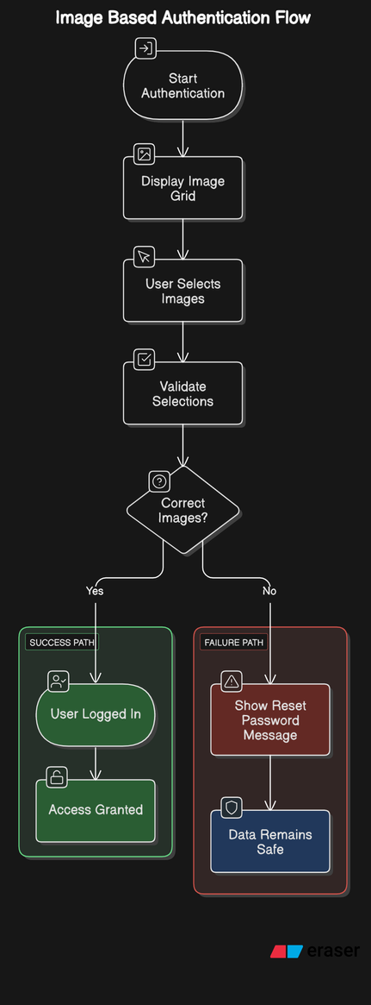
UML DIAGRAM

Slide 12
References
R. Biddle, S. Chiasson, and P. C. van Oorschot, “Graphical passwords: Learning from the first twelve years,” ACM Comput. Surveys, vol. 44, no. 4, 2012.
The Science Behind Pass Faces [Online]. Available: http://www.realuser.com/published/ScienceBehindPassfaces.pdf
*
<number> of 12

Slide 13
THANK YOU
*
(#) of 12

